Slide 1

COMPUTER NETWORKS
Animesh Giri
Department of Computer Science & Engineering

Slide 2

COMPUTER NETWORKS
Transport Layer
Animesh Giri
Department of Computer Science & Engineering

Slide 3

COMPUTER NETWORKS
Connectionless Transport: UDP
Animesh Giri
Department of Computer Science & Engineering

Slide 4
In this segment
COMPUTER NETWORKS
UDP: User Datagram Protocol [RFC 768]
UDP: segment header
UDP Checksum
Internet Checksum: example
Internet Checksum: weak protection!
Summary

Slide 5
COMPUTER NETWORKS
UDP: User Datagram Protocol [RFC 768]
“no frills,” “bare bones” Internet transport protocol
“best effort” service, UDP segments may be:
lost
delivered out-of-order to app
connectionless:
no handshaking between UDP sender, receiver
each UDP segment handled independently of others
why is there a UDP?
no connection establishment (which can add delay)
simple: no connection state at sender, receiver
small header size
no congestion control
UDP can blast away as fast as desired
can function in the face of congestion

Slide 6
COMPUTER NETWORKS
UDP: User Datagram Protocol [RFC 768]
UDP use:
streaming multimedia apps (loss tolerant, rate sensitive)
DNS
SNMP
If reliable transfer needed over UDP:
add needed reliability at application layer
application-specific error recovery!
add congestion control at application layer

Slide 7
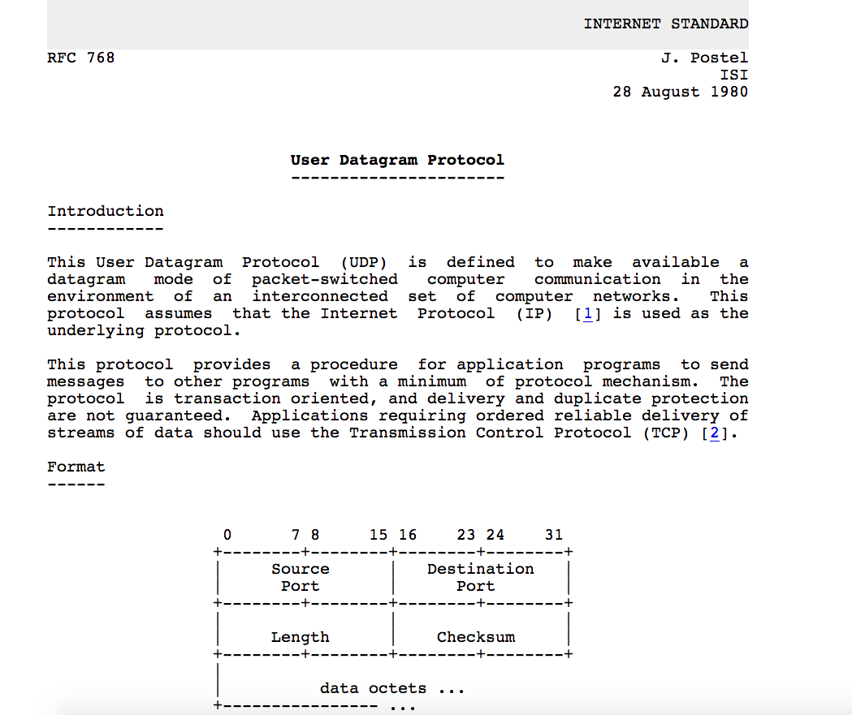
COMPUTER NETWORKS
UDP: User Datagram Protocol [RFC 768]

Slide 8
COMPUTER NETWORKS
UDP: Transport Layer Actions
SNMP client
SNMP server
application
application
transport
(UDP)
transport
(UDP)
network (IP)
network (IP)
link
link
physical
physical

Slide 9
COMPUTER NETWORKS
UDP: Transport Layer Actions
SNMP client
SNMP server
UDP sender actions:
application
application
is passed an application-layer message
SNMP msg
transport
(UDP)
transport
(UDP)
determines UDP segment header fields values
UDP_{h}
SNMP msg
UDP_{h}
creates UDP segment
network (IP)
network (IP)
passes segment to IP
link
link
physical
physical

Slide 10
COMPUTER NETWORKS
UDP: Transport Layer Actions
SNMP client
SNMP server
UDP receiver actions:
application
receives segment from IP
application
checks UDP checksum header value
transport
(UDP)
transport
(UDP)
SNMP msg
extracts application-layer message
network (IP)
network (IP)
SNMP msg
UDP_{h}
demultiplexes message up to application via socket
link
link
physical
physical

Slide 11
COMPUTER NETWORKS
UDP: segment header
length, in bytes of UDP segment, including header
32 bits
source port #
dest port #
length
checksum
application
data
(payload)
UDP segment format

Slide 12

COMPUTER NETWORKS
UDP Checksum
Goal: detect “errors” (e.g., flipped bits) in transmitted segment
1st number
2nd number
sum
Transmitted: 5 6 11
Received: 4 6 11
receiver-computed
checksum
=
sender-computed
checksum (as received)

Slide 13
COMPUTER NETWORKS
UDP Checksum
Goal: detect “errors” (e.g., flipped bits) in transmitted segment
sender:
treat segment contents, including header fields, as sequence of 16-bit integers
checksum: addition (one’s complement sum) of segment contents
sender puts checksum value into UDP checksum field
receiver:
compute checksum of received segment
check if computed checksum equals checksum field value:
NO - error detected
YES - no error detected. But maybe errors nonetheless? More later …

Slide 14
COMPUTER NETWORKS
Internet Checksum: example
example: add two 16-bit integers
1 1 1 1 0 0 1 1 0 0 1 1 0 0 1 1 0
1 1 1 0 1 0 1 0 1 0 1 0 1 0 1 0 1
1 1 0 1 1 1 0 1 1 1 0 1 1 1 0 1 1
1 1 0 1 1 1 0 1 1 1 0 1 1 1 1 0 0
1 0 1 0 0 0 1 0 0 0 1 0 0 0 0 1 1
wraparound
sum
checksum
Note: when adding numbers, a carryout from the most significant bit needs to be added to the result

Slide 15
COMPUTER NETWORKS
Internet Checksum: Weak protection!
example: add two 16-bit integers
0 1
1 1 1 0 0 1 1 0 0 1 1 0 0 1 1 0
1 0
1 1 0 1 0 1 0 1 0 1 0 1 0 1 0 1
wraparound
1 1 0 1 1 1 0 1 1 1 0 1 1 1 0 1 1
Even though numbers have changed (bit flips), no change in checksum!
sum
1 0 1 1 1 0 1 1 1 0 1 1 1 1 0 0
checksum
0 1 0 0 0 1 0 0 0 1 0 0 0 0 1 1

Slide 16
COMPUTER NETWORKS
Summary
“no frills” protocol:
segments may be lost, delivered out of order
best effort service: “send and hope for the best”
UDP has its plusses:
no setup/handshaking needed (no RTT incurred)
can function when network service is compromised
helps with reliability (checksum)
build additional functionality on top of UDP in application layer (e.g., HTTP/3)

Slide 17
THANK YOU
Animesh Giri
Department of Computer Science & Engineering
animeshgiri@pes.edu
+91 80 6618 6603

